Slide 1


ER Diagram

Slide 2
What is ER Diagram?
ER Diagram stands for Entity Relationship Diagram, also known as ERD is a diagram that displays the relationship of entity sets stored in a database. In other words, ER diagrams help to explain the logical structure of databases. ER diagrams are created based on three basic concepts: entities, attributes, and relationships.
ER Diagrams contain different symbols that use rectangles to represent entities, ovals to define attributes, and diamond shapes to represent relationships.

Slide 3
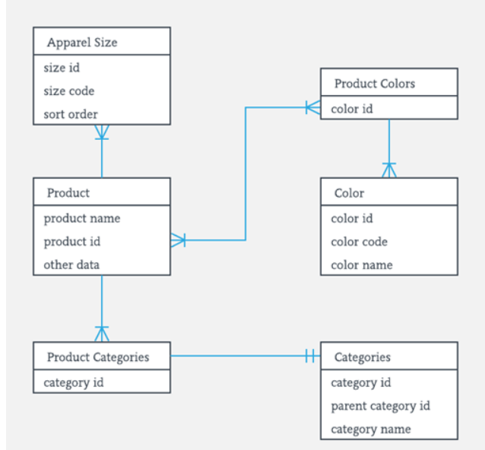
Continue…
ER Diagrams contain different symbols that use rectangles to represent entities, ovals to define attributes, and diamond shapes to represent relationships.

Slide 4
What is ER Model?
ER Model stands for Entity Relationship Model is a high-level conceptual data model diagram. ER model helps to systematically analyze data requirements to produce a well-designed database.
The ER Model represents real-world entities and the relationships between them. Creating an ER Model in DBMS is considered as a best practice before implementing your database.
ER Modeling helps you to analyze data requirements systematically to produce a well-designed database. So, it is considered a best practice to complete ER modeling before implementing your database.

Slide 5
History of ER models
ER diagrams are visual tools that are helpful to represent the ER model. Peter Chen proposed ER Diagram in 1971 to create a uniform convention that can be used for relational databases and networks. He aimed to use an ER model as a conceptual modeling approach.

Slide 6
Why use ER Diagrams?
Helps you to define terms related to entity relationship modeling.
Provide a preview of how all your tables should connect, and what fields are going to be on each table.
Helps to describe entities, attributes, and relationships.
ER diagrams are translatable into relational tables which allows you to build databases quickly.
ER diagrams can be used by database designers as a blueprint for implementing data in specific software applications.

Slide 7
Continue..
The database designer gains a better understanding of the information to be contained in the database with the help of an ERP diagram.
ERD Diagram allows you to communicate the logical structure of the database to users.

Slide 8
Facts about ER Diagram Model
ER model allows you to draw Database Design.
It is an easy-to-use graphical tool for modeling data.
Widely used in Database Design.
It is a GUI representation of the logical structure of a Database.
It helps you to identify the entities which exist in a system and the relationships between those entities.

Slide 9
Components of the ER Diagram
This model is based on three basic concepts:
Entities
Attributes
Relationships

Slide 10
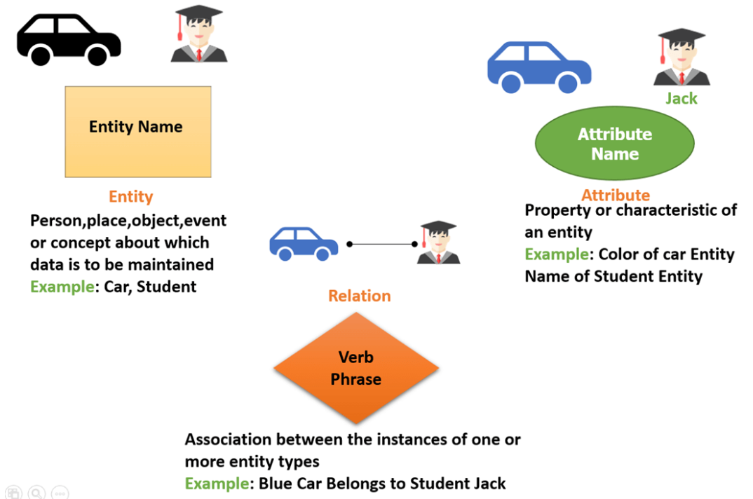
ER Diagram Examples
For example, in a University database, we might have entities for Students, Courses, and Lecturers. Students’ entities can have attributes like Rollno, Name, and DeptID. They might have relationships with Courses and Lecturers.

Slide 11
WHAT IS ENTITY?
A real-world thing either living or non-living that is easily recognizable and nonrecognizable. It is anything in the enterprise that is to be represented in our database.
It may be a physical thing or simply a fact about the enterprise or an event that happens in the real world.
An entity can be a place, person, object, event or concept, that stores data in the database

Slide 12
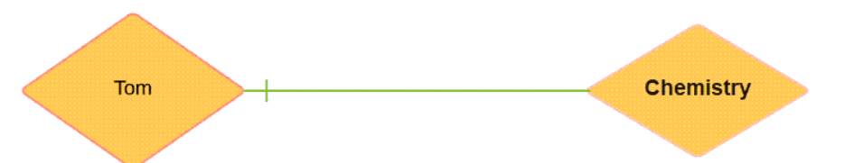
Relationship
Relationship is nothing but an association among two or more entities. E.g., Tom works in the Chemistry department.

Slide 13
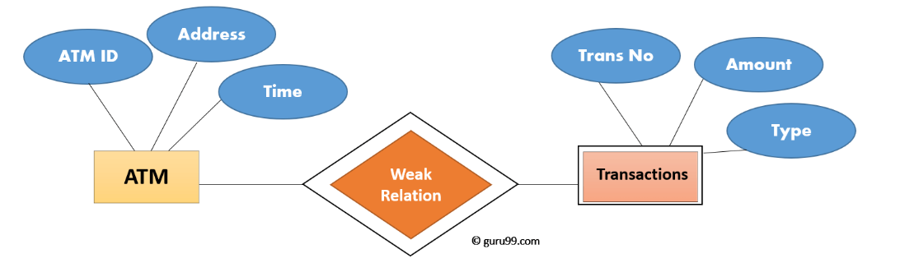
Weak Entities
A weak entity is a type of entity that doesn’t have its key attribute. It can be identified uniquely by considering the primary key of another entity. For that, weak entity sets need to have participation.

Slide 14
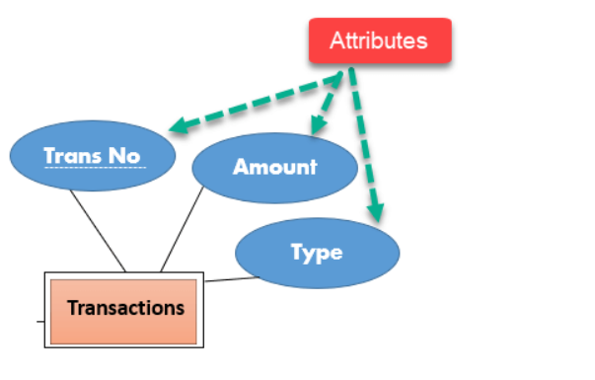
Attributes
It is a single-valued property of either an entity type or a relationship type.
For example, a lecture might have attributes: time, date, duration, place, etc.
An attribute in ER Diagram examples, is represented by an Ellipse.

Slide 15
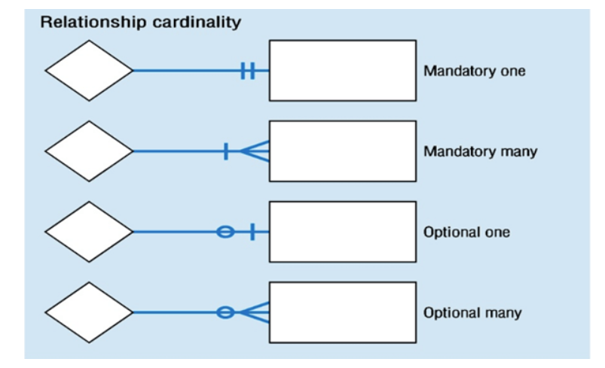
Cardinality
Defines the numerical attributes of the relationship between two entities or entity sets.
Different types of cardinal relationships are:
One-to-One Relationships
One-to-Many Relationships
May to One Relationship
Many-to-Many Relationships

Slide 16
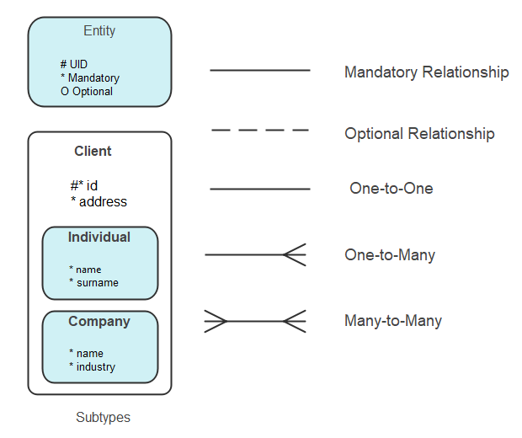

Slide 17
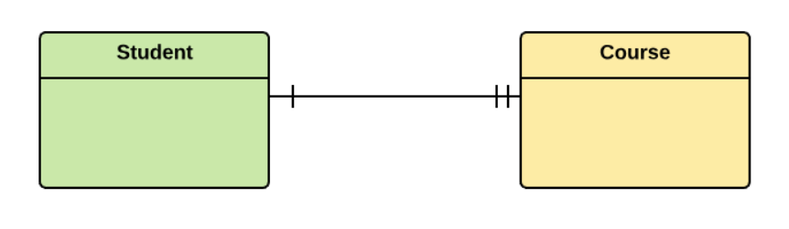
One-to-one
One entity from entity set X can be associated with at most one entity of entity set Y and vice versa.
Example: One student can register for numerous courses. However, all those courses have a single line back to that one student.

Slide 18
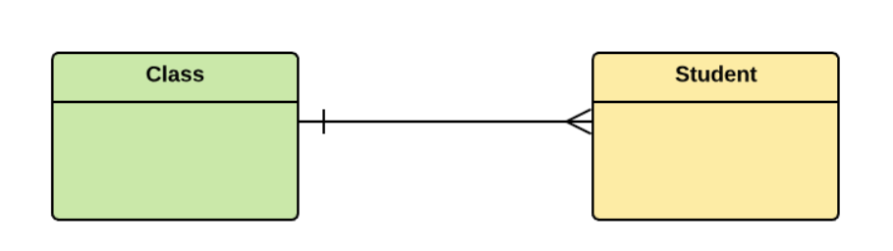
One-to-many
One entity from entity set X can be associated with multiple entities of entity set Y, but an entity from entity set Y can be associated with at least one entity.
For example, one class is consisting of multiple students.

Slide 19
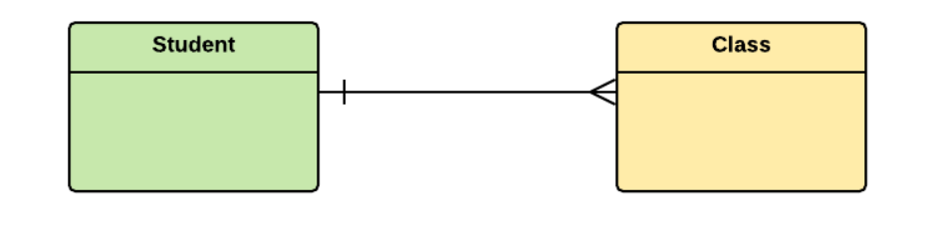
Many to One
More than one entity from entity set X can be associated with at most one entity of entity set Y. However, an entity from entity set Y may or may not be associated with more than one entity from entity set X.
For example, many students belong to the same class.

Slide 20
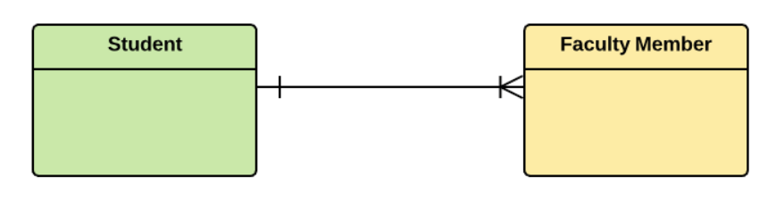
Many to Many
One entity from X can be associated with more than one entity from Y and vice versa.
For example, Students as a group are associated with multiple faculty members, and faculty members can be associated with multiple students.

Slide 21




How to Create an Entity Relationship Diagram (ERD) In MySQL Workbench
Create a database.
Insert the table inside the database.

Slide 22

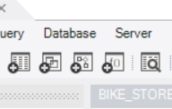
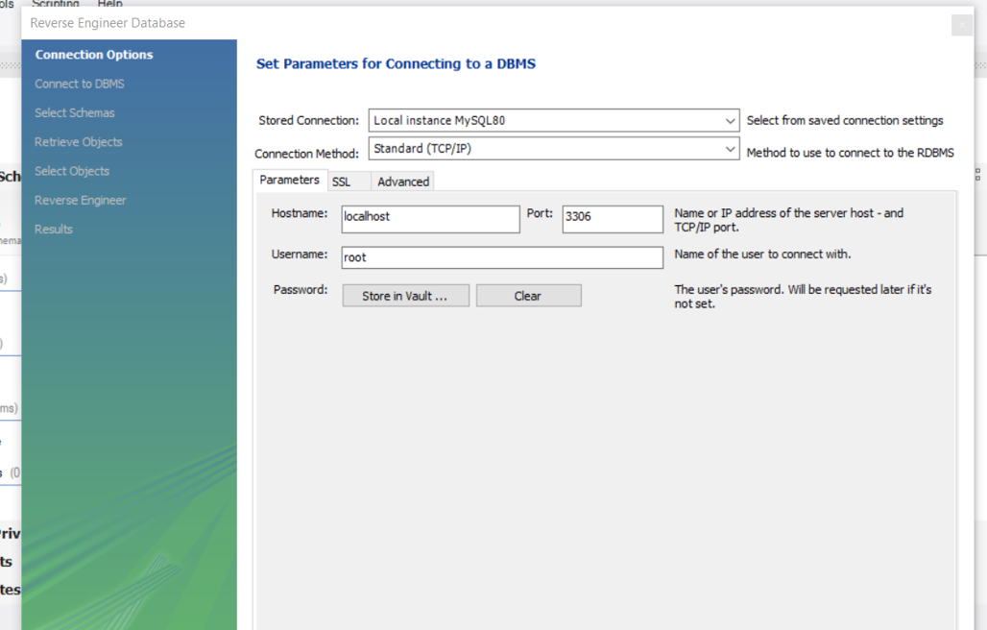
Follow The Steps As Shown Below
Click on the database from the ribbon
Then Select Reverse Engineer

Slide 23
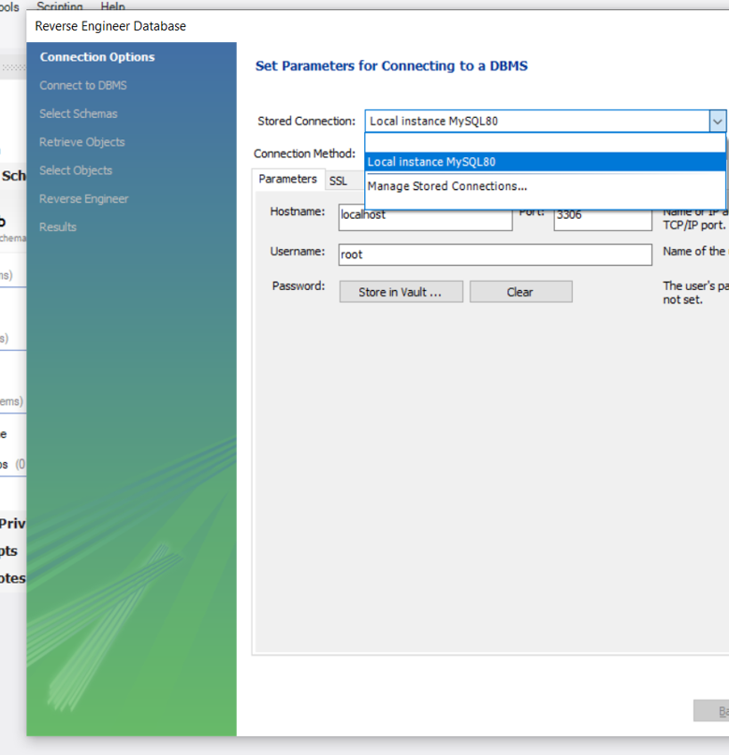
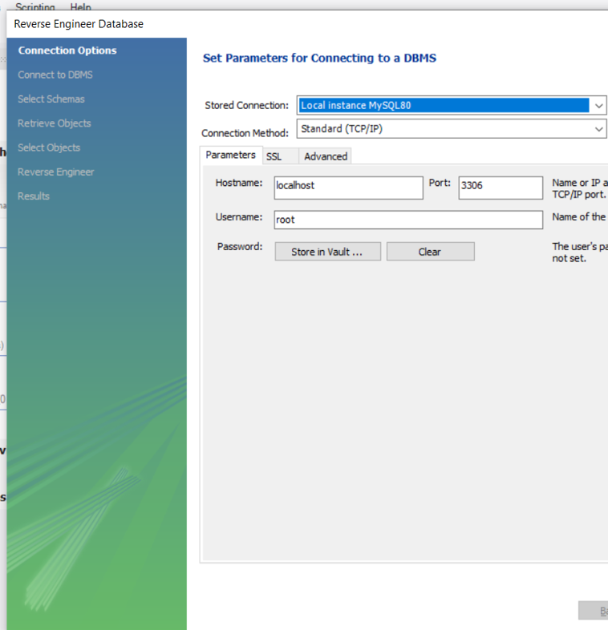

Slide 24
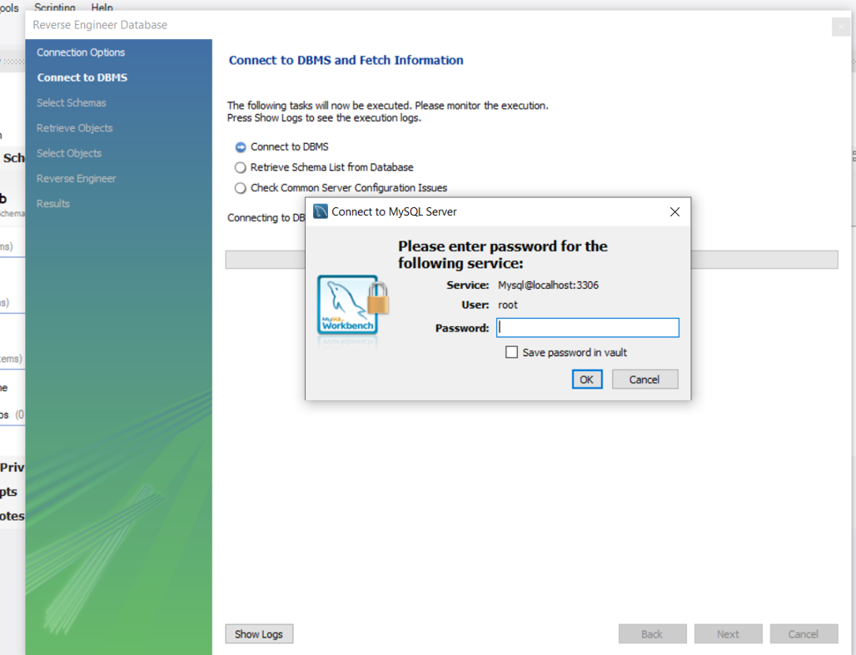
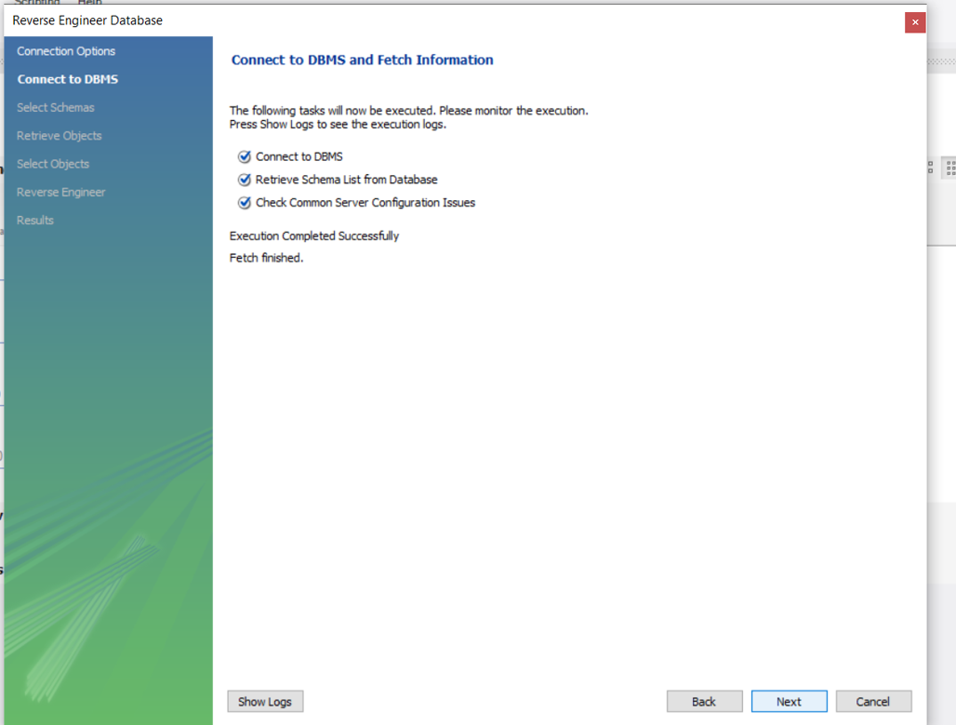

Slide 25
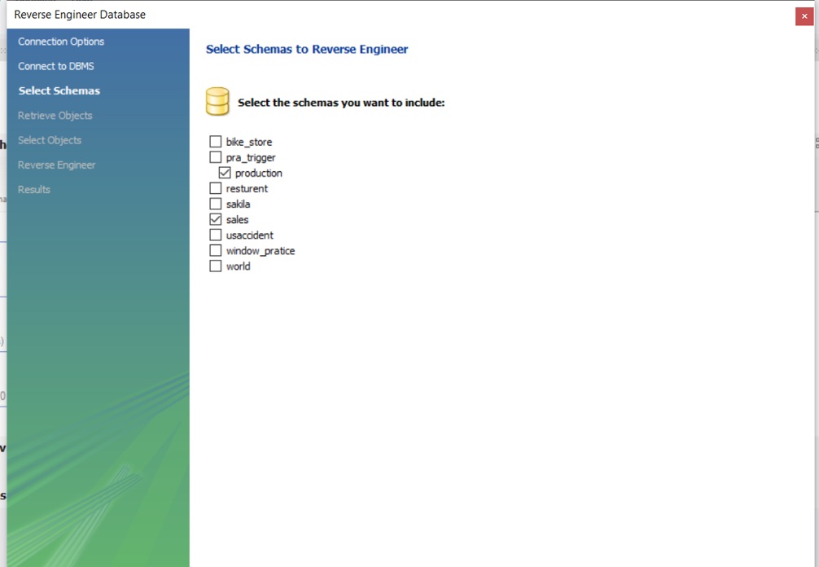
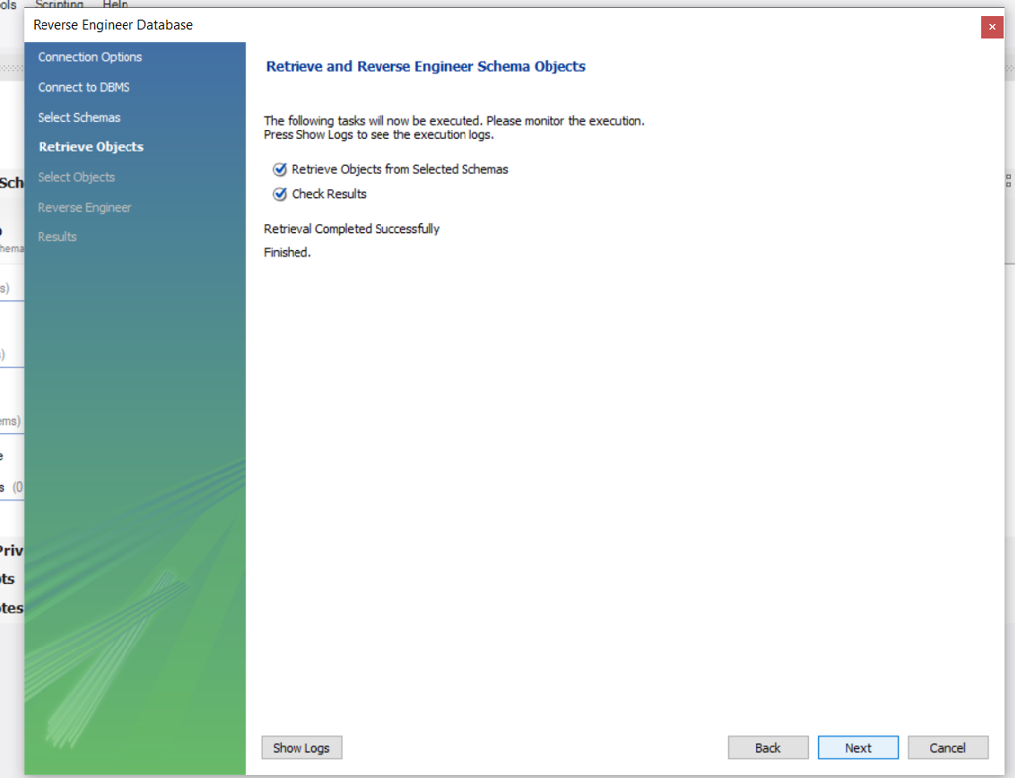

Slide 26
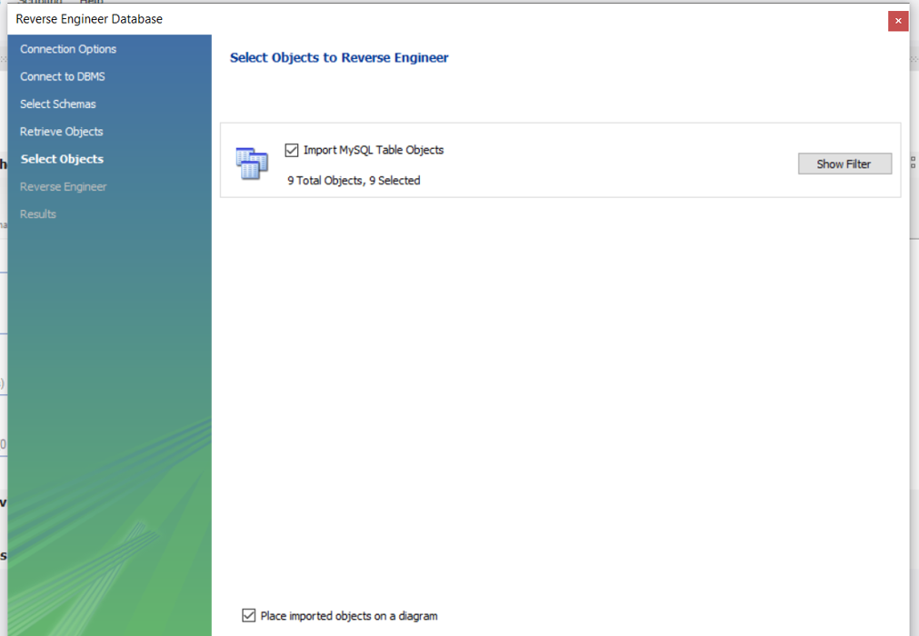
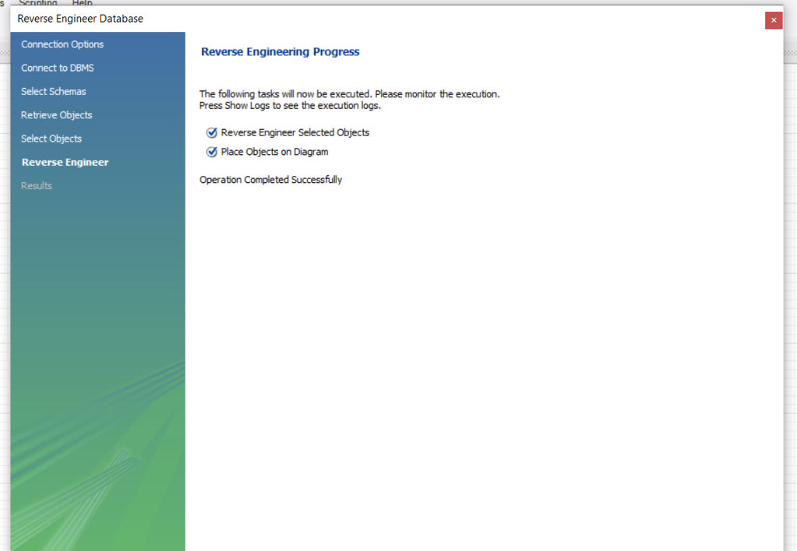

Slide 27
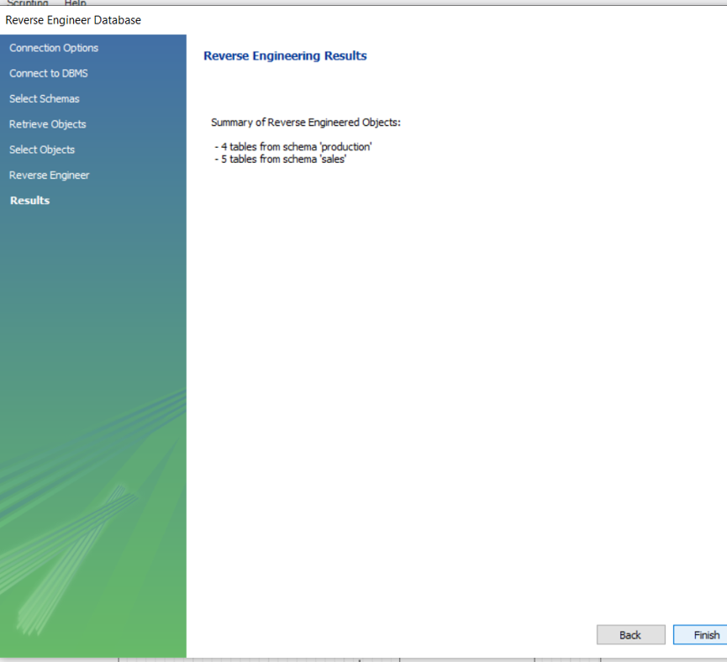

Slide 28
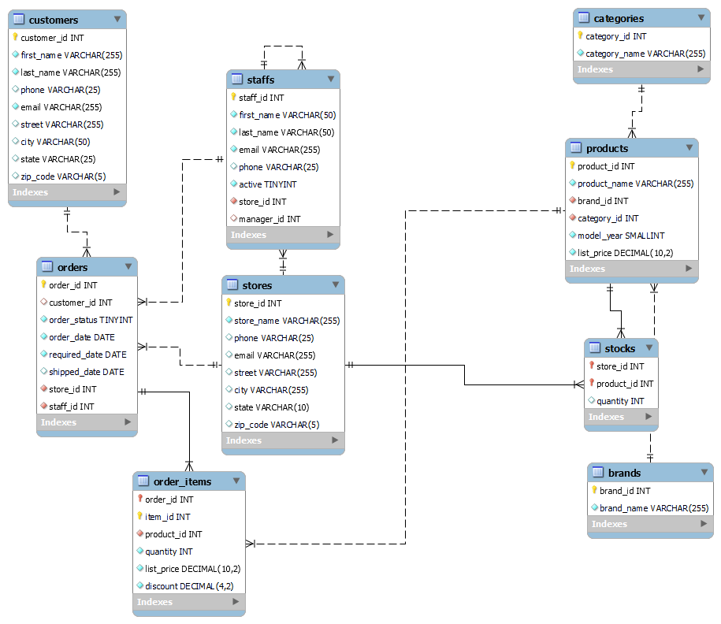

Slide 29
Thank you

